Slide 1

Staff Briefing: National Child Measurement Programme Video for Pupils
What is the National Child Measurement Programme (NCMP)?
The NCMP measures the height and weight of children in Reception class and Year 6, to assess overweight and obesity levels in children within primary schools. In Manchester, the measurement process is overseen by the Screening Team, who are part of the School Health Service. The data collected from these measurements guides local service planning for children and assists in identifying those who may benefit from weight management support.
Purpose of the video
Explain the NCMP process using drawings and voiceovers created by children.
To help pupils understand what will happen, why it happens, and what they can expect, reducing anxiety and uncertainty.
To support a calm, respectful, and non-judgemental approach to measurement.
Key messages for school staff to reinforce
Measurements are taken privately, respectfully, and carefully.
Results are not shared with teachers or other pupils.
If students have questions that are not addressed in the video, they should be shared with the school staff member organising the screening, who can then email the screening team.
What the video covers
Briefly explains what the NCMP is and why it happens nationally.
Shows what will happen on the day (height and weight measurement).
Signposts pupils to speak to a school staff member if they would like to speak to a School Nurse.
Safeguarding and sensitivity notes
Be aware of pupils who may appear anxious or withdrawn.
Any worries should be handled in a private setting, following school safeguarding procedures.
If you are concerned about a child's weight impacting their health, please refer the child to the School Nurses (aged 5-16 years) using the referral forms on this padlet or refer the child to the Healthy Weight Team (aged 3-5 years) using this email: mft.healthyweightteam@nhs.net.
Eligible children in Manchester can access the Physical Activity Referral Service, a 10-week programme that helps families access affordable, enjoyable local activities tailored to their needs. Parents and carers can self-refer using this link.
Helpful resources for promoting healthy lifestyles are available on this Padlet.
Schools can promote healthy living through a whole school health approach; contact healthy.schools@mft.nhs.uk for more info.
After the video
Signpost pupils to:
Trusted adults at home and in school
School nurse
Screening team (whilst they are in school)

Slide 2



National Child Measurement Programme
Notes:
1

Slide 3
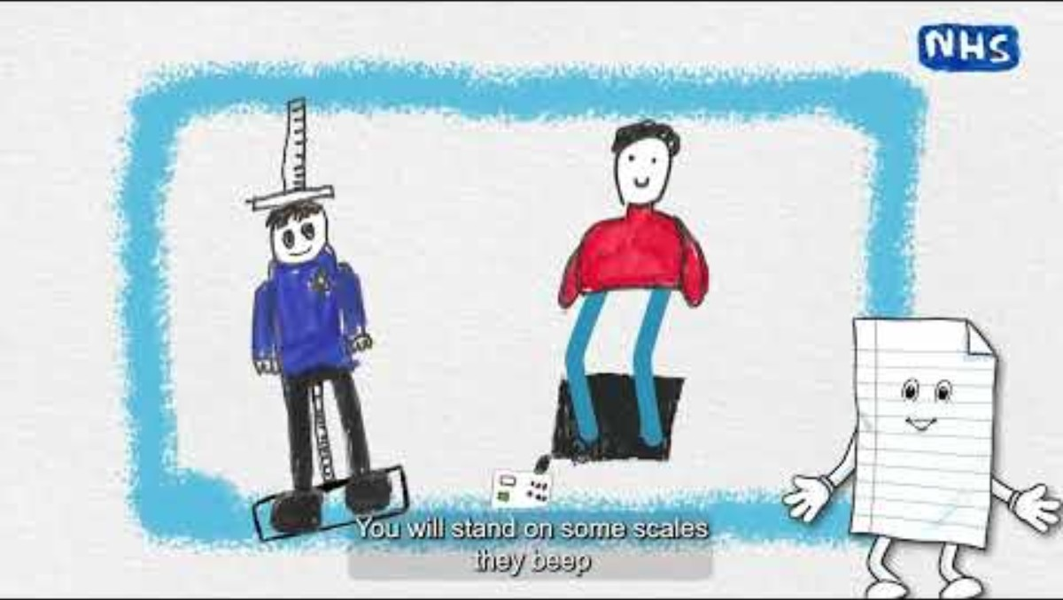
Notes:
Video link: https://youtu.be/L_DqdtjqHZA?si=vx6WCYFw6R-DMi5b
Please contact healthy.schools@mft.nhs.uk if you are unable to access the video.

Slide 4




Speak to Childline.
Speak to a trusted adult in school.
Further support
Speak to a School Nurse.
Speak to a trusted adult at home.

