Slide 1

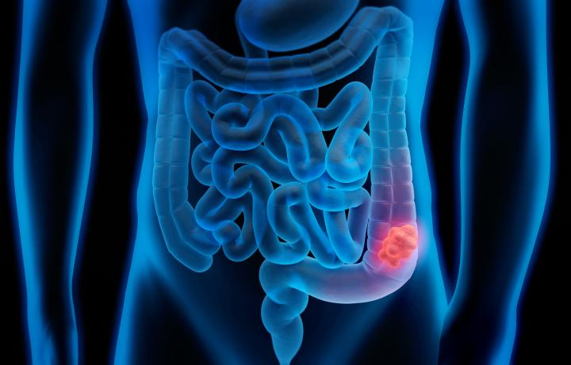
Manchester Bowel Cancer Screening Programme
Improving early diagnosis of bowel cancer through the NHS Bowel Cancer Screening Programme
Johnson Liu (Cancer Screening Improvement Lead)
E: johnson.liu@mft.nhs.uk
T: 07881 541343

Slide 2
Aims of The Bowel Cancer Screening Programme (BCSP)
To detect bowel cancer at an early stage and from people with no symptoms
Identify and invite those eligible for screening (aged 52 years until 74th birthday) at every 2-year interval. Patients over 75 can still take part: they need to call 0800 707 6060 to request a kit.
Recent Age Extension to the BCSP (Patients aged 50 will be invited in 2025):
56-year-olds from 20th June 2022
58-year-olds from 10th Aug 2022
54-year-olds from 25th Sep 2023
52-year-olds from 1st Sep 2024 (anyone born 31st Aug and before will have to wait until their 54th birthday to receive their first bowel screening kit)
Prevent cancer where possible, and lead to earlier detection, appropriate referral and improved outcomes i.e. better treatment and recovery time
The BCSP is an NHS Gold Standard Service – all staff required extensive training and accreditation to work for a National Screening Programme

Slide 3
Key Facts about Bowel Cancer
Over 42,300 people are diagnosed with bowel cancer every year in the UK (2015 – 2017), that’s more than 115 people every day
4th most common cancer & 2nd biggest cancer killer in the UK
16,000 people die from bowel cancer in the UK every year
About 1 in 20 people in the UK will develop bowel cancer during their lifetime
94% of new cases of bowel cancer are diagnosed in people over the age of 50
1 in 15 men and 1 in 18 women will be diagnosed with bowel cancer during their lifetime
When diagnosed at its earliest stage, more than 9/10 (92%) people will survive their disease for five years or more. This is compared with 1 in 10 (10%) people when diagnosed at the latest stage.

Slide 4
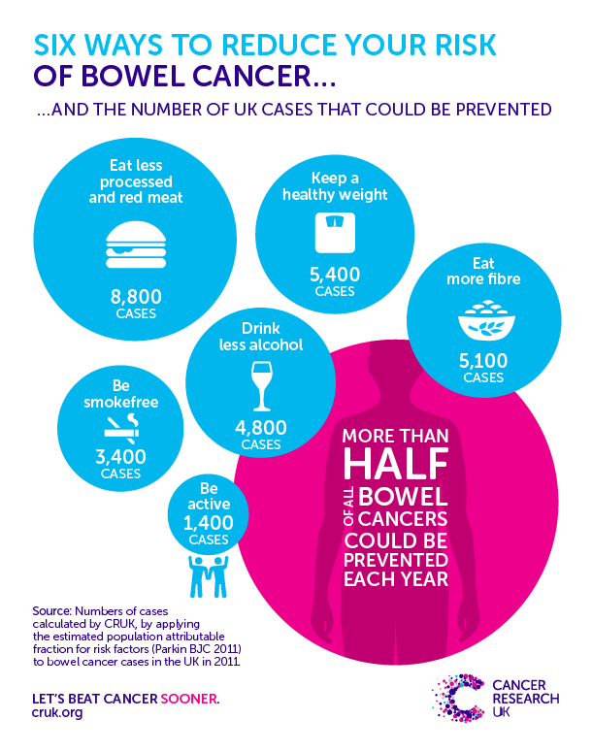
Risk Factors
Age – over 80% of bowel cancer occur in those over 60s
Low fibre diet – 28% of cases
Family history – 20% of cases
Eating processed red meat – 13% of cases
Overweight and obesity – 11% of cases
Smoking – 7% of cases
Excess alcohol – 6% of cases
Lack of regular exercise – 5% of cases
54% of bowel cancer cases are preventable, UK
1 in 15 UK males and 1 in 18 UK females will be diagnosed in their lifetime
Inflammatory Bowel Disease & Type 2 Diabetes
Source: https://www.bowelcanceruk.org.uk/about-bowel-cancer/bowel-cancer/

Slide 5
What is Bowel Cancer?
Bowel cancer is cancer that starts in the large bowel (colon) or back passage (rectum)
Bowel cancer forms through polyps that grow on the lining of the inside of the large bowel
Not all polyps contain cancerous cells, yet if left long enough, some can become cancerous and become tumours.
Symptoms of Bowel Cancer
More than 90% of people with bowel cancer have one or a combination of the following symptoms:
A persistent change in bowel habit
Bleeding from the bottom and/or blood in your poo
Abdominal pain, discomfort or bloating brought on by eating
Unexplained weight lost and extreme tiredness for no obvious reason
Most people with these symptoms do not have bowel cancer. However, it is vital that patients see their GP if they have the above symptoms for more than 3 weeks.

Slide 6
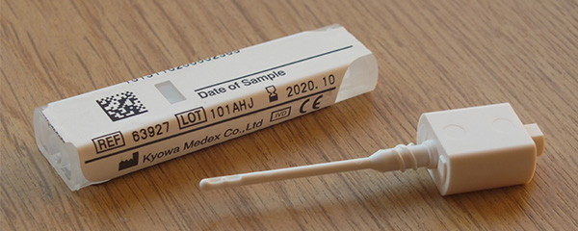
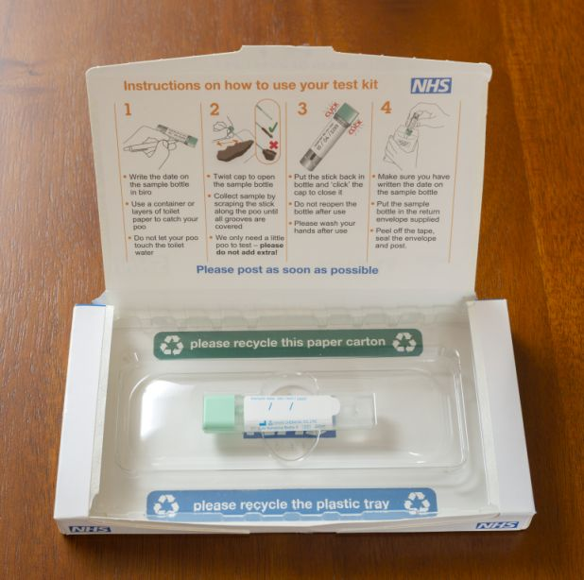
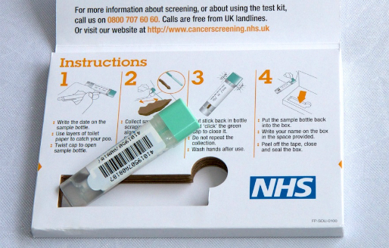
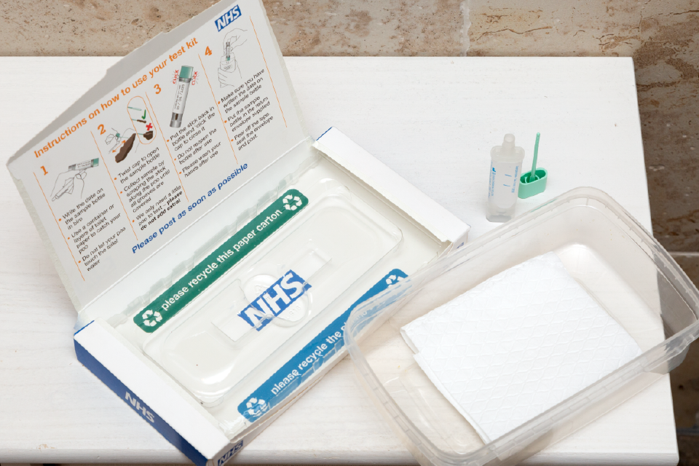
The Faecal Immunochemical Test (FIT) Kit
The FIT kit is simple, easy and hygienic to complete
Only one small poo sample is required
The FIT kit looks for very small traces of blood
An abnormal result is NOT a cancer diagnosis
98 out of 100 completed FIT kits require no further test. 2/100 require a colonoscopy
More people are completing the FIT kit compared to previous FOBT (average 7% increase)
2WW symptomatic FIT is more sensitive than screening FIT
Common problems – too much poo & not writing sample date on bottle

Slide 7
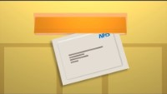
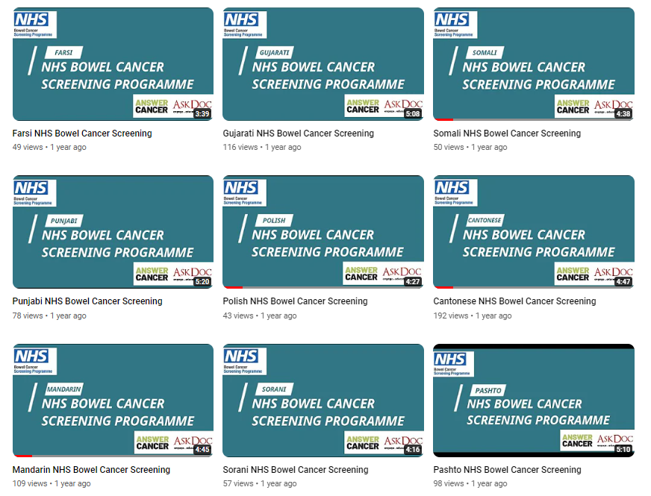
The Faecal Immunochemical Test (FIT) Kit
https://youtu.be/il6VSceMWfM
https://www.youtube.com/channel/UCuKnnetqTZOVLzfv5nIhUWw/videos

Slide 8
Abnormal/Positive Result:
This is not a cancer diagnosis
This means that further tests/investigation is required i.e. colonoscopy procedure
Patient will receive an invitation letter (with date/time) to attend a telephone or a face-to-face consultation
During consultation, the Specialist Screening Practitioner will assess and identify if patient is suitable for a colonoscopy
Normal/Negative Result:
No human blood detected from the FIT kit. Patient will receive another FIT kit in two years' time
If patient receives a FIT kit aged 74 then this will be their last invite. However, they can continue taking part in bowel screening by contacting Hub to request a kit every 2 years.

Slide 9

What Happens at a Specialist Screening Practitioner (SSP) Assessment/Consultation
The Hub will send an invitation letter for a scheduled SSP appointment (telephone)
The assessment will take about 45 minutes
SSP will assess patient to identify if they are:
  Medically fit for a colonoscopy & bowel prep
  Current health condition
  Identify what current medication they are taking
  Obtain consent from patient
  Confirm colonoscopy appointment
  SSP may need to contact GPs and other clinical staff to confirm if they are well enough to take part in the BCSP
  Translators are available and will need to be requested by contacting Hub or Screening Centre

Slide 10
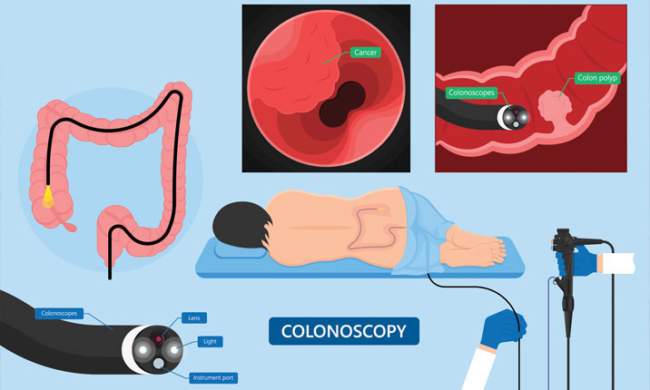
The Colonoscopy Procedure
Colonoscopies take place at Manchester Royal Infirmary, Withington Community Hospital and Trafford General Hospital
Translator can be requested for colonoscopy procedure
Patients are required to eat a LOW fibre diet leading up to colonoscopy procedure
Patient will need to take a laxative (Bowel Prep) before their colonoscopy
A sedative or gas and air is offered to patient to help them relax during procedure
Procedure takes around 20 minutes
Patient will receive a call from SSP the following day to check if they are ok
The BCSP is a Gold Standard service – additional clinical training required

Slide 11
The Role of the BCSP Hub (Rugby)
To manage patient call and recall for the bowel screening programme
To provide a telephone help line for people invited for screening
To dispatch and process bowel screening FIT kits
Send result letters to participants and notify their GP
Book the first SSP assessment date/time for patients with an abnormal screening test result
Work in partnership with Screening Centres to increase uptake in low performing areas
1st point of call for patients. Free phone line – 0800 707 60 60.

Slide 12
Who is Less Likely to Engage with Bowel Screening?
Men are more likely to ignore their invitations than women. Just 53% of men complete their bowel screening test compared with 58% for women
Men are more at risk of getting bowel cancer – 44% of cases in female v 56% of cases in men. 1 in 5 men will be diagnosed during their lifetime
Ethnically diverse community groups are less likely to engage with the bowel screening programme due to personal and cultural reasons, language difficulties, hygiene reasons and a lack of awareness/understanding of cancer screening programme
People with physical and/or learning disabilities are less likely to engage with the bowel screening programme
People living in socially deprived neighbourhoods are less likely to engage with the bowel screening programme (35% for the most deprived groups compared to 61% for the least deprived)
Bowel screening is for people with no symptoms relating to their bowel. As a result, people who feel that they have no problems with their bowels are the people that we would like to screen.

Slide 13

What are the barriers to preventing people taking part in the bowel cancer screening?

Slide 14
Barriers Stopping People Engaging with the BCSP
Physical/mental disability
Lack of GP endorsement
Burden/concern for friends/family
Other people’s attitude towards cancer
Worried about getting cancer
I’m fit and healthy
Pain
Scared
Lack of social support from friends/family
Misunderstanding the word ‘screening’
Invasive procedure
Fear & Denial
Stigma
COVID-19
Existing symptoms
Transportation
Cultural reasons
Religious reasons
Unhygienic
Personal attitude
Previous bad experience
Language
Finance
Misconception
Anxiety
Personal reasons
Not registered with a GP
Embarrassment
Don’t understand how to complete FIT kit
Low health literacy and numeracy

Slide 15
The Benefits of Bowel Screening
Reduces your risks of dying from bowel cancer by at least 25%
Screening detects cancers at an early stage when there is a better chance of successful treatment and less time spent recovering
Screening can find polyps and remove them to reduce future risk of developing bowel cancer
Preventive screening help patient learn what their body is not telling them
Bowel screening is very cost effective
The Risks of Bowel Screening
No screening test is 100% reliable. Screening may not detect all bowel cancer
A false abnormal test outcome could result in having a colonoscopy even though there is nothing wrong
Bowel cancer can occur in the two-year period between each FIT screening kit
There is a small risk of perforation, but this is very rare.

Slide 16
How to Improve Uptake to Bowel Screening
A GP-endorsed letter along with a bowel screening leaflet (including images of FIT kit) can increase uptake by 12% - ensure letter is written to suit your population (in English and native language)
Telephoning and speaking to non-responders by phone is the most effective way to increase uptake. This can increase uptake by 8% when used in combination with a GP-endorsed letter previously sent to non-responder
Face to face intervention by Practice staff (when used with GP endorsed letter) can increase uptake by 5%. Setup a flagging system on EMIS to remind staff to speak to non-responder
Sending enhanced text messages including web links to leaflets, videos & other information can improve awareness and engagement
Use translated information or AskDoc videos to help overcome communication difficulties
Send a letter or text message to patients who have recently turned 52, 54, 56, 58 or 60 (first-timers) to remind them about the bowel screening programme – first timers are really important!
Target a specific cohort of patients to increase uptake i.e. LD patients, patients with a specific language or religion; or from a particular postcode area; or just men or a particular age group
Campaigns – displays & videos in waiting areas, Bowel Cancer Awareness month (Apr), social media, Answer Cancer, posters, leaflets, PPG meetings, newsletters, social prescribing
Have a system in place: run regular monthly/weekly searches, code correctly & be consistent

Slide 17
Requesting Replacement Bowel Screening FIT Kits for Non-Responder
Aim:
To help increase uptake by ordering replacement kits for non-responders who may have misplaced or lost their original bowel screening FIT kit
For Practices with bowel screening uptake rates below 60% only
Process for practice staff:
Undertake EMIS search to identify eligible non-responders for bowel screening
Telephone non-responder to encourage uptake by asking:
  Have they received their bowel screening FIT kit?
  Do they know the test kit is for? And how to complete and return test kit?
  Ensure sample date is written on FIT kit and only a small amount of sample is needed
  Do they need a replacement kit? Complete spreadsheet and send to CSIL
  Ensure patient consent to share address with Hub to ensure delivery of FIT Kit
  Follow up with a text message to remind patient to complete FIT kit
  CSIL can check and provide updates for Practice staff on status for each non-responder

Slide 18
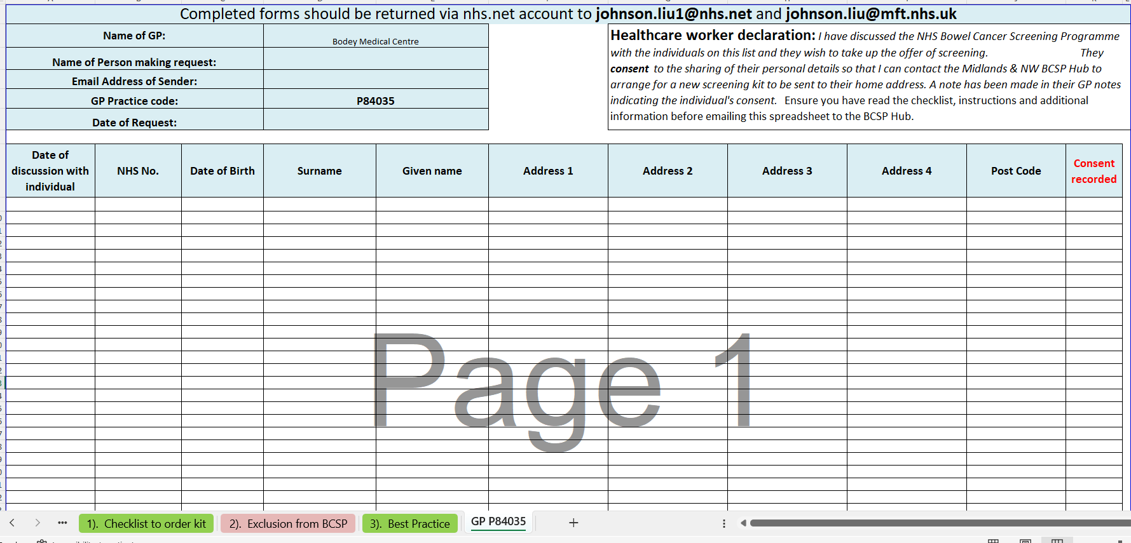
Requesting Replacement Bowel Screening FIT Kits for Non-Responder
SAMPLE ONLY

Slide 19
Top Tips with Engaging Non-Responders
Try to avoid using the word ‘cancer’ as this can automatically worry or cause anxiety to patients
  Alternatives could include: ‘bowel check up’, ‘bowel screening programme’ or the ‘Poo test kit’
  Speak slowly, do not use medical jargon or abbreviated words; take time to listen; build up a rapport; show patience and be friendly and welcoming
  Be upfront and ask the questions you need to ask:
    Has the patient received the NHS bowel screening kit?
    Have they still got it? Can they make sure they compete the kit?
    Do they need to contact Hub to order a new one?
    Explain that your GP would like you to complete this kit? Encourage them!
  Remember screening is a choice – do not force patients to take part in cancer screening
  Think of an exit strategy to help end any lengthy conversation with patient to save time
  Be aware of the common barriers to bowel screening & think of ways to overcome them
  Schedule older patients earlier in the day: making calls earlier in the day maybe more beneficial for older people as they may get tired later in the day

Slide 20
Resources to Engage Non-Responders
Promotional materials for in-house campaigns & website:
How to use bowel screening FIT kit leaflet in various languages –
https://www.gov.uk/government/publications/bowel-cancer-screening-kit-how-to-use
NHS bowel cancer screening: helping you decide (FIT kit) in various languages –
https://www.gov.uk/government/publications/bowel-cancer-screening-benefits-and-risks
NHS bowel cancer screening: having a colonoscopy in various languages –
https://www.gov.uk/government/publications/bowel-cancer-screening-colonoscopy/bowel-cancer-screening-having-a-colonoscopy-fit
Easy read guide for patients with learning disabilities –
https://www.gov.uk/government/publications/bowel-cancer-screening-easy-guide
https://assets.publishing.service.gov.uk/government/uploads/system/uploads/attachment_data/file/806904/BCSP_FIT_easy_read_final.pdf
Having a Colonoscopy easy read guide –
https://static1.squarespace.com/static/551cfff9e4b0f74d74cb307e/t/567a9e3edf40f3a5265acabc/1450876478007/easy-guide-having-a-colonoscopy.pdf
Booklets, posters and fact sheets from Bowel Cancer UK charity –
https://www.bowelcanceruk.org.uk/about-bowel-cancer/our-publications/
Early diagnosis booklets, posters and leaflets from Cancer Research UK charity –
https://publications.cancerresearchuk.org/early-diagnosis
Public Health England’s Help Us Help You campaign - https://campaignresources.phe.gov.uk/resources/search

Slide 21
Resources to Engage Non-Responders
Translated GP Endorsement Letters and Text Messages:
https://mft.nhs.uk/mri/services/gastroenterology-and-hepatology/mri-endoscopy/bowel-cancer-screening-programme/ (click under News and Blogs section for letters/text)
AskDoc videos in local languages (to send to non-responders via text message):
https://www.youtube.com/playlist?list=PLH_-FJAzzeYbhV0MO7xKUXXJY75XxmuHt
Telephone script, fact sheet & common enquiries:
Information to update GP Website:
Video links to send to patient’s mobile phone/GP waiting area & website:
How to complete the bowel screening FIT kit video (subtitled in various languages) - https://vimeo.com/showcase/6663813/
Cancer Research how to complete FIT kit video - https://www.youtube.com/watch?v=il6VSceMWfM
What happens during a colonoscopy video - https://www.youtube.com/watch?v=wK2imf6w8Pw
Bowel screening and Covid-19 video - https://www.youtube.com/watch?v=m3PZEkfEnYk

Slide 22
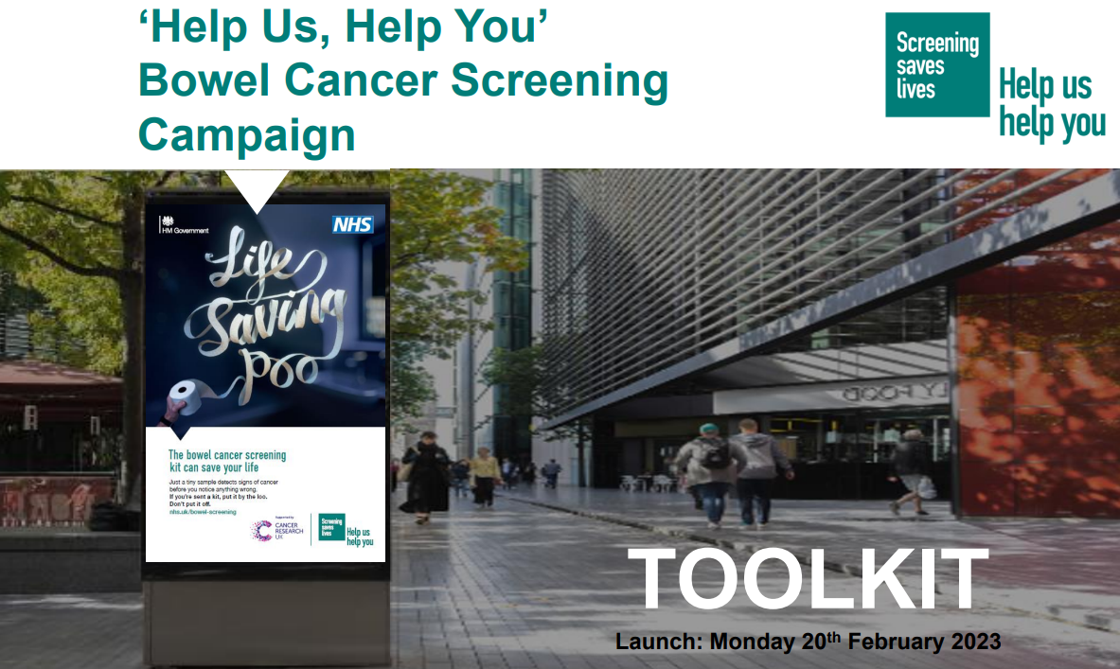

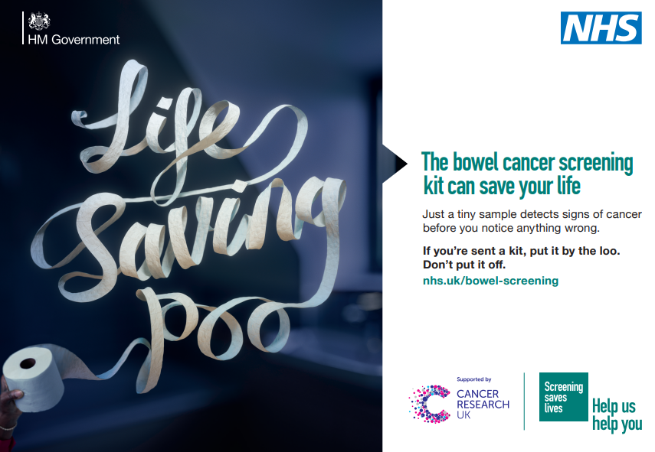
New Promotional and Campaign Resources!
National BCSP Campaign 20/02/23 to 31/03/23: Campaign Resource Centre (dhsc.gov.uk)
Posters, social media videos, logos, TV commercial, digital screens, esignatures, community radio, campaign toolkit
Bowel cancer screening campaign webinar: Bowel cancer screening campaign webinar 03.02.2023 - CommsLink - FutureNHS Collaboration Platform

Slide 23
Further Training Opportunities (updated 26/11/23)
Answer Cancer - https://www.answercancergm.org.uk/
https://www.answercancergm.org.uk/training-courses/
GatewayC - https://www.gatewayc.org.uk/
https://www.gatewayc.org.uk/courses/national-screening-programmes-bowel-screening/
World Cancer Research Fund - https://www.wcrf-uk.org/
https://www.wcrf-uk.org/health-professionals/cpd-for-health-professionals/online-cancer-prevention-course/
NHS England elearning for healthcare - https://portal.e-lfh.org.uk/
https://portal.e-lfh.org.uk/Catalogue/Index?HierarchyId=0_43382&programmeId=43382
FutureLearn - https://www.futurelearn.com/
https://www.futurelearn.com/courses/talking-about-cancer
Bowel Cancer UK - Bowel Cancer UK – YouTube
Learn about bowel cancer - YouTube

Slide 24
Helping Patients with a Learning Disability to Access BCSP
NHS Bowel Cancer Screening: Easy Read Guide
https://assets.publishing.service.gov.uk/government/uploads/system/uploads/attachment_data/file/806904/BCSP_FIT_easy_read_final.pdf
Having a Colonoscopy:- Easy Read Guide
https://www.sath.nhs.uk/wp-content/uploads/2020/09/Bowel-cancer-screening-colonoscopy-easy-guide.pdf
Having a CTC Bowel Screening Scan
https://www.sath.nhs.uk/wp-content/uploads/2020/09/CTC-scan.pdf
BSL (British Sign Language) Video on How to Use FIT Kit
https://phescreening.blog.gov.uk/2020/12/07/bowel-cancer-animation-now-available-in-british-sign-language/
Bowel Screening Video for people with Learning Disabilities
https://www.youtube.com/watch?v=QXV2noZLUFU

Slide 25
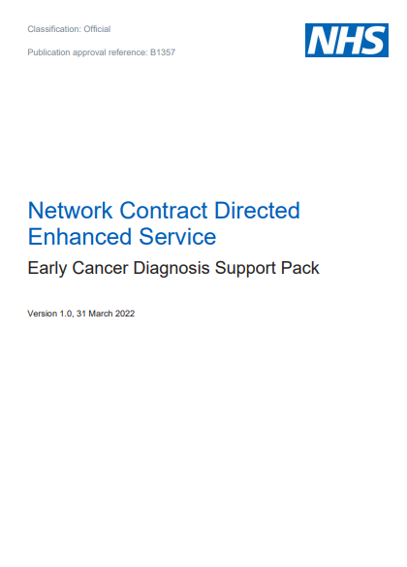
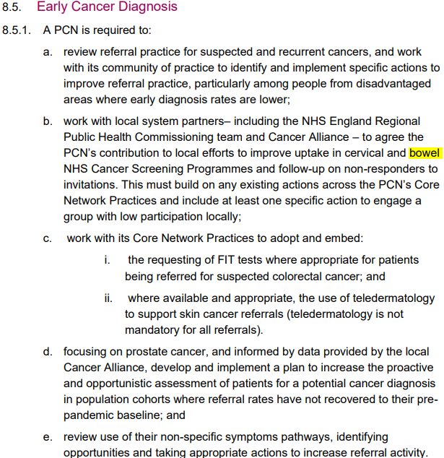

GP Requirement to Help Improve Early Cancer Diagnosis
Improvement work to increase uptake to bowel screening is essential and required as part of your contractual agreement through the Network Contract Directed Enhanced Service (section 8.5) and the NHS long term plan to diagnosis 75% of all cancer diagnosis at an early stage
CSIL are required to report back to Commissioners, Cancer Alliance Partners, PCN Cancer Leads, NHSE & Local Authorities on GP improvement plans

Slide 26
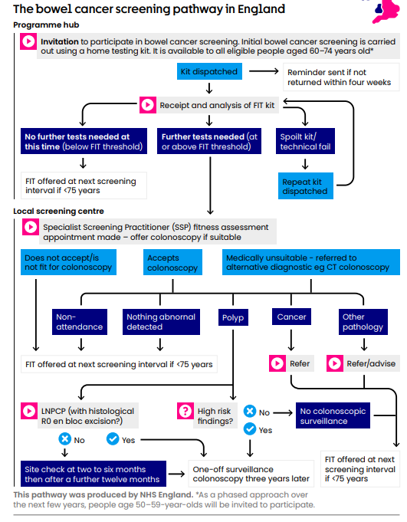

Slide 27
Screening is beneficial to health, but it is ultimately an individual choice
Johnson Liu
Bowel Cancer Screening Improvement Lead
The Manchester (Withington) Screening Centre
Bowel Cancer Screening Programme
C/o Renal Administration Offices
Ground Floor, New MRI
Manchester Royal Infirmary
Oxford Road
Manchester
M13 9WL
T: (0161) 701 4622
Mobile – 07881 541343

