Slide 1

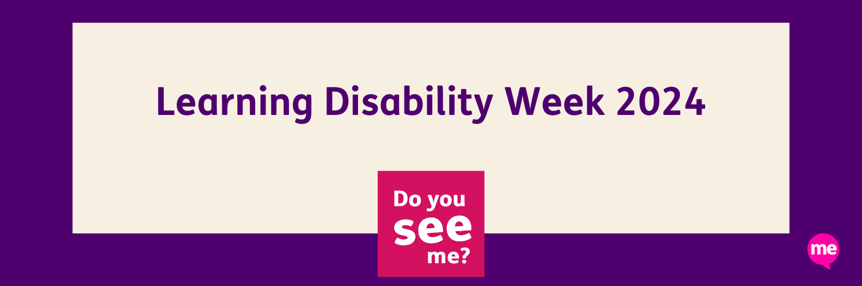
Do you understand me?
- Let’s Talk about Communication
Speech and Language Therapy – Community Adult Learning Disability Service (CALDS)

Slide 2
Learning Disability and Communication Needs
Within the population of people with a learning disability, it is estimated 50-90% have difficulties with communication (RCSLT, 2019).
Each person’s communication needs are individual depending on:
  Their level of learning disability
  Whether they have any co-occurring diagnoses (e.g. sensory impairment, Autism, physical disability, acquired conditions such as a stroke, etc)
  Whether they have tools in place to meet their communication needs

Slide 3
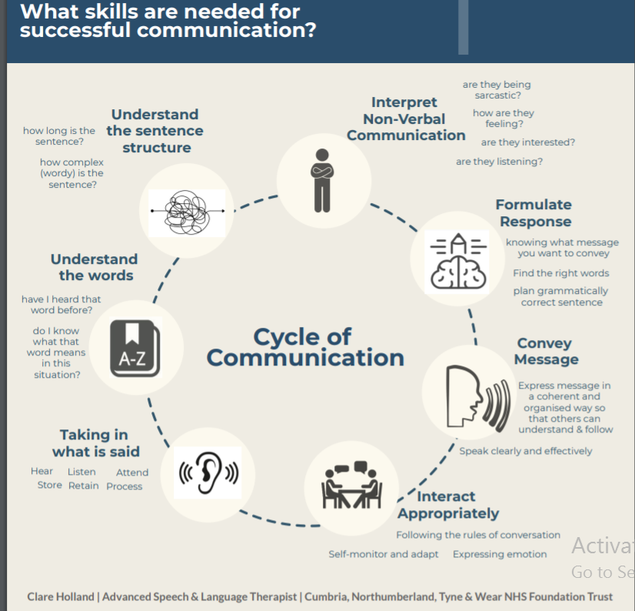
How does Communication Happen?
Communication requires a person to send a message and another person to receive the message.
During this session we will cover both how people may express themselves (communication) and how people understand information given to them (understanding).

Slide 4
Difficulty Communicating… What are the Risks for the Person?
There are major implications for a person’s overall health if they are unable to express their needs effectively. Common issues include:
  Expressing the level, severity and intensity of pain
  Describing symptoms accurately
  Explaining the frequency and location of symptoms
  Frustration at not being able to express themselves clearly, which can sometimes lead to changes in behaviour e.g. hitting out, self injury, shouting, withdrawal and wider impact on mental health.
A person may not comply with medical procedures or with taking medication if they do not understand the reasons for this.
Notes:
Level, severity and intensity of pain – people may end up with untreated or ineffective treatment for pain if they are unable to indicate their level of pain. Health conditions causing pain may go undiagnosed if the person struggles to express that they are in pain.
Description of symptoms- people may not be able to accurately explain how the symptoms feel or report all of the symptoms and therefore certain conditions may be missed
Frequency and location of symptoms- the severity of the health issue may not be picked up on if the person struggles to talk about how often something occurs. If they struggle to accurately talk about where in the body they experience the symptom, they may be misdiagnosed.
A person may become frustrated if they are unable to express themselves effectively, which can lead to changes in behaviour e.g. hitting out, self injury, shouting, withdrawal and impact on mental health.
If the person has difficulties with understanding they may not recognise the reason an assessment or procedure is required. They may not understand the reason they need to take particular medications which can lead to poor symptom control and worsening health.
The person may not fully understand their treatment plan and therefore may carry this out incorrectly, potentially worsening their health.

Slide 5
Factors that may affect a person’s communication
Poor physical health, pain or medication effects
Mental health - fear, anxiety, feeling uncomfortable
Poorly supported sensory impairment
Distracting environment e.g. too much noise, being interrupted
Busy environment, e.g. not enough time to process information, lots of information given in a short space of time
Previous experience of being misunderstood or ignored
Lack of access to resources/tools that would help e.g. communication device not charged, communication chart not within reach.
Notes:
If the person is in pain they may struggle to communicate, may be more withdrawn or may communicate in an aggressive manner e.g. shouting, swearing.
Some medication can affect alertness which may cause the person to communicate less. Some medication can impact on muscle function and strength which could cause speech to be less clear.
If the person has an undiagnosed hearing impairment this will impact greatly on their ability to understand what is said to them.
Hospitals and clinics tend to be busy environments – someone with low volume may struggle to make themselves heard. Someone with a stammer may stammer more if the person they are communicating with rushes them.
Some people will need additional time to understand, process and retain information and if there are staffing pressures this can sometimes mean people are given less time to think about what is being asked of them.
Some people may have previous negative experiences of being in hospital and as a result may withdraw or not attempt to make their needs known.
Many people need additional tools to help them express themselves effectively- if those tools are not within reach and working this makes it harder to communicate effectively.

Slide 6
Communication Difficulties may Involve:
Limited vocabulary- may not know a word or may use one word for multiple meanings.
Limited use of grammar, which can cause ambiguity:
  Using the correct tense e.g. “It was hurting” vs “it is hurting”
  Using pronouns – especially confusion of gender e.g. he for she, him for her .
  Word changes for plurals e.g. “fall” vs “falls”, “pain” vs “pains”
  Use of “the” and “a/an” and this/that e.g. “the man” means a specific man, “a man” does not.
Limited amount of information in a sentence and difficulty joining sentences.
Difficulties using various language functions e.g. can name but not describe.
Speech difficulties that may impact on intelligibility.
Physical disability may cause difficulties using some non verbal communication e.g. gestures.
Notes:
Vocabulary use can be more limited for people with learning disabilities. Some people may not know the word to use e.g. for body parts or may use one word to refer to multiple things e.g. ‘bleeding’ might mean blood but could also be referring to a scab or a healed cut. This can cause ambiguity.
Difficulties with using the correct grammar can affect how well the person is able to explain something, such as whether pain is ongoing, whether there are more than one symptoms.
Difficulties joining sentences means it is difficult to give more detailed explanations or to talk about the order of events leading up to an injury.
Limited amount of information in a sentence, which can be linked to a limited vocabulary or limited grammar or even speech difficulties. It can affect having enough words to describe what something may look like, emotions about a particular topic, or to establish preferences.
The person may not use all language functions. They may be able to label their hand but may not be able to describe what they feel is wrong with their hand.
If a person has difficulties using clear speech this could impact on being able to get their message across clearly and could cause frustration.

Slide 7
How to Support Communication Needs:
Read documentation about the person e.g. hospital traffic light.
Ask the person/ carers about how to best support their communication.
Accept and encourage all communication e.g. speech, sign, gesture, drawing, demonstration / action replay.
Ensure pens and paper are available.
Use photos and pictures to support the person to communicate. Communication boards, visual pain scales, body maps.
If the person has an electronic communication device encourage them to use it.
Some people may need to use actual objects to help explain something clearly e.g. through demonstrating.
Watch the person and observe what they may tell you through their body language and facial expression.
Check with the person that you understand what they are saying e.g. "the TVs not working? Is that right?"
Notes:
Read documentation to learn about the person’s communication skills e.g. hospital traffic light, communication reports, etc.
Speak to the person to find out their preferred method of communication and also ask carers or family members how they support the person to communicate.
Accept and encourage all communication e.g. speech, sign, gesture, drawing, demonstration / action replay. If the person wants to show you what they mean- go with them.
Ensure pens and paper are available for the person to write or draw what they mean.
Use photos and pictures to support the person to communicate – using communication boards the person can point to a picture of something they need/ want. An example of this is using images for food menu choices.
Check if the person’s communication device is charged and that they have it with them.
Some people may need to use actual objects to help explain something clearly e.g. through demonstrating.
Watch the person and observe what they may tell you through their body language and facial expression.
Establish what you will do if you misunderstand e.g. ask again, ask the carer.
Check with the person that you understand what they are saying e.g. "the TVs not working? Is that right?"

Slide 8
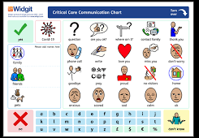
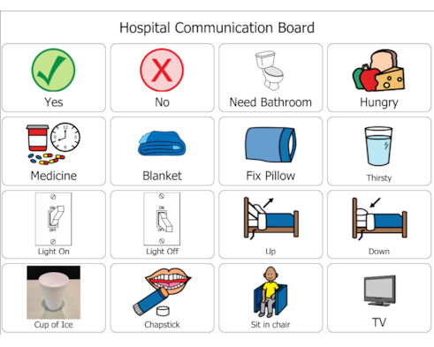
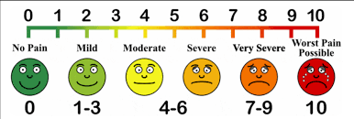
Communication tools
Examples of communication boards
An example of a visual pain scale

Slide 9
Signing
Some people need signs to help them understand, some people need signs to help them express themselves
Signing is visual - easier to process and remember. It is less fleeting than a spoken word. It uses different muscles to spoken words.
There are different types of signing:
BSL (British Sign Language) is a true language. It has its own grammar that is very different to English.
Sign Supported English is where people use signs alongside speaking English. The signs might be taken from British Sign Language but used in English word order. Or they might be from Makaton or Signalong.
Some people may use the fingerspelling alphabet.
Some people may make up their own version of signs or adapt them slightly- check with people that know them well to clarify what a sign means.
Notes:
If the person uses sign language, check what type of sign language they use.
If the person uses idiosyncratic signs- check if they have a signing dictionary which explains what their signs mean.
Try using some key signs alongside your speech to help the person understand what is said.

Slide 10
Difficulties with Understanding may Involve:
Limited understanding of vocabulary.
Difficulty understanding negatives in a sentence e.g. “That isn’t yours”. These sentences are often understood as positive statements i.e. “That’s yours”.
Difficulty understanding more than one piece of verbal information at a time.
Difficulties understanding some questions e.g. ‘when’, ‘how’, ‘why’.
Difficulty understanding phrases of time e.g., weekly, next month, frequently
An inability to understand that the words “might”, “may”, “could” express a possibility not a certainty.
Difficulty understanding idioms, jokes, teasing, sarcasm and irony.
Difficulty recognising that they’ve misunderstood another person’s communication or agreeing to what someone says because of lack of understanding or to appease the person.
Limited understanding of other people's communication e.g. lack of understanding of objects, routines, facial expressions, tone of voice.
Notes:
Vocabulary knowledge depends on exposure to the specific words and experience of it’s meaning- often impacted by schooling. People with learning disabilities tend to understand a simple word rather than a complex word e.g. cut vs incision. Some people with learning disability may only understand a few everyday words e.g. car, mum, cup.
Negatives are grammatical parts of a sentence- often people with learning disability may simply focus on the man information words in the sentence and so may miss out the negative part. This can result in misunderstandings.
‘what?’ and yes/ no questions are usually easier for someone to understand and answer. Try asking simple questions.
Time is an abstract concept to understand for many people. Use time words that the person knows and avoid using complex words to talk about time e.g. often, frequently, rarely, annually.
Try to explain things that are certain rather than possibilities. If this is difficult due to the circumstances, try telling the person about all the different outcomes that may occur e.g. ‘you will go home today or tomorrow’ instead of ‘you might go home today’.
Avoid using language that could be taken literally e.g. sarcasm, idioms (e.g. a pain in the neck) as these can cause confusion if misinterpreted.
Sometimes people may nod along and agree with something if they have not recognised they don’t understand or if they do not want to say they do not understand. This can often happen when the other person is viewed as having more power / authority (e.g. patient/ doctor).
Some people with more severe learning disability may have difficulty understanding what objects refer to or what gestures mean. Facial expressions may be misinterpreted.

Slide 11
How to Support Understanding:
Read documentation about the person and speak to carers and family members.
Find somewhere without distraction. Reduce background noise.
Use accessible language- every day common words and avoid jargon and acronyms.
Avoid using complex sentences, keep it short and simple.
Allow plenty of time for them to process the information and repeat information when needed.
Ask open questions and if the person finds this hard to answer, try asking simple “what?” and yes/ no questions or offer choices.
Look out for signs the person doesn’t understand. Check back to ensure they understand.
Try drawing and writing key points to help explain what you mean.
Use pictures to help the person understand the key points being said. Make sure to follow the Accessible Information Standards (NHS England).
Use real objects, demonstration and video recordings to help a person understand.
Make sure your facial expression matches your tone of voice and the words you use. If you're asking if someone is happy or unhappy, make your facial expression correspond to reinforce what you're saying.
Notes:
Read communication reports and hospital traffic lights to find out about what types of information the person understands.
Speak to carer to find out what information the person understands and how to best support their understanding.
Be mindful of the person’s sensory impairment and distractibility- try to reduce distraction and background noise where possible.
Use simple words and avoid using any complex words or jargon that might be hard to understand. Find out what word the person uses for something and use that word e.g. ‘bum’ for bottom.
Use consistent words e.g. don’t switch between saying ‘medicine’ and ‘tablets’.
Make sure you use short, simple sentences and make one point at a time.
Allow plenty of time in between each point before giving more information. This will help with processing the information.
Remember that why, how and when questions are more difficult to understand and answer. Try to simplify these.
Check the person understands- don’t just ask ‘do you understand?’ see if they can re-explain it in their own words.
Utilise pictures, demonstration using objects and watching videos on the topic to help the person understand. Sometimes taking a video of the person carrying out their therapy exercise on their own phone might help them remember and understand what to do when they go home.
Make sure your tone of voice and facial expression match with the words you use, otherwise this can be confusing.

Slide 12
Thank you for your time!
Please contact the SLTs in the Community Adult Learning Disability Service if you require any further support or advice.

