Slide 1
WBN WAY

Slide 2
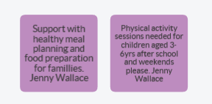
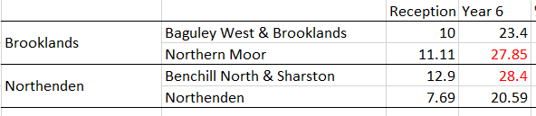

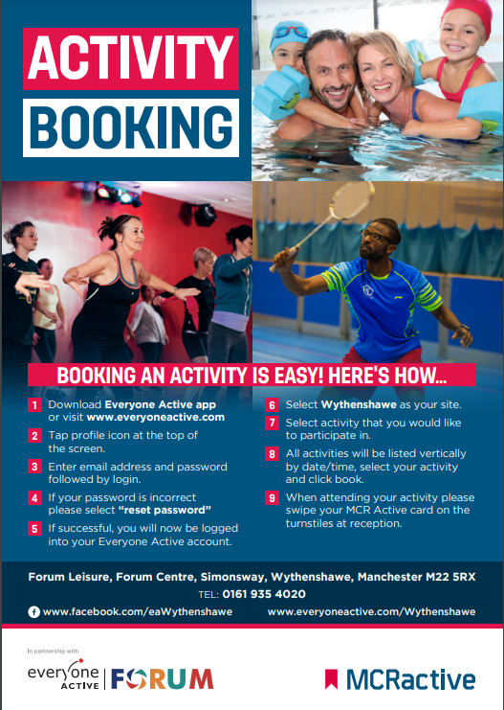
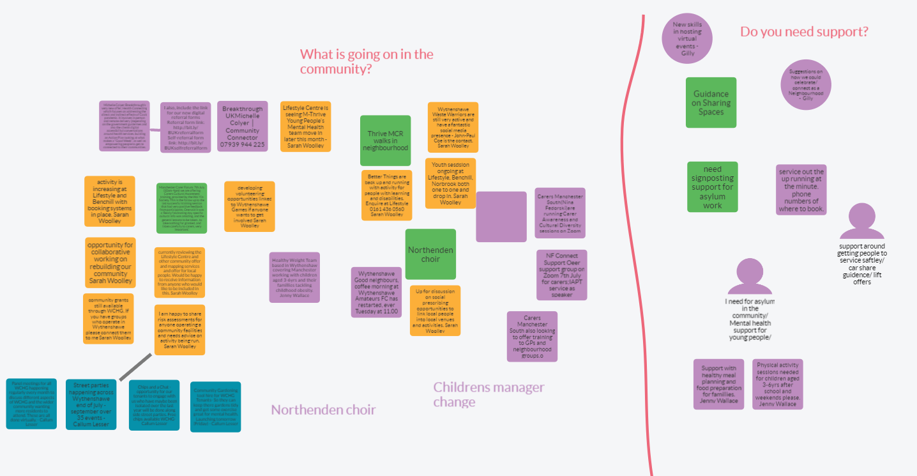

Eat Well, Move More, Feel Better
What & Why
Targeted data led approach – started with conversations
“Lower numbers of families accessing sport and leisure facilities” Everyone Active
“We are seeing rising obesity levels” The Willows
“Depleting offer for 3-6year olds” Healthy weight team @ n’hood partnership mtg
We mapped the NCMP data to
MSOA to identify schools
Ambition
Take a collaborative approach to improving health and wellbeing of families in Wythenshawe
Develop a place-based team to work on healthy weight in Wythenshawe
– pilot an approach, build evidence, look for sustainability funding
Improve practical cooking skills & family activity levels
Whole school approach
Improved knowledge of neighbourhood offer
Workforce training
10-week family activity & wellbeing programme
Who
Parents & Families
Benchill & The Willows Primary Schools
Blossom
Forum Trust
Everyone Active
MLCO – Neighbourhoods
MLCO – Healthy Weight Team
MLCO- Healthy Schools Team
MCC - Population health
More Life
MCC - Neighbourhoods

Slide 3
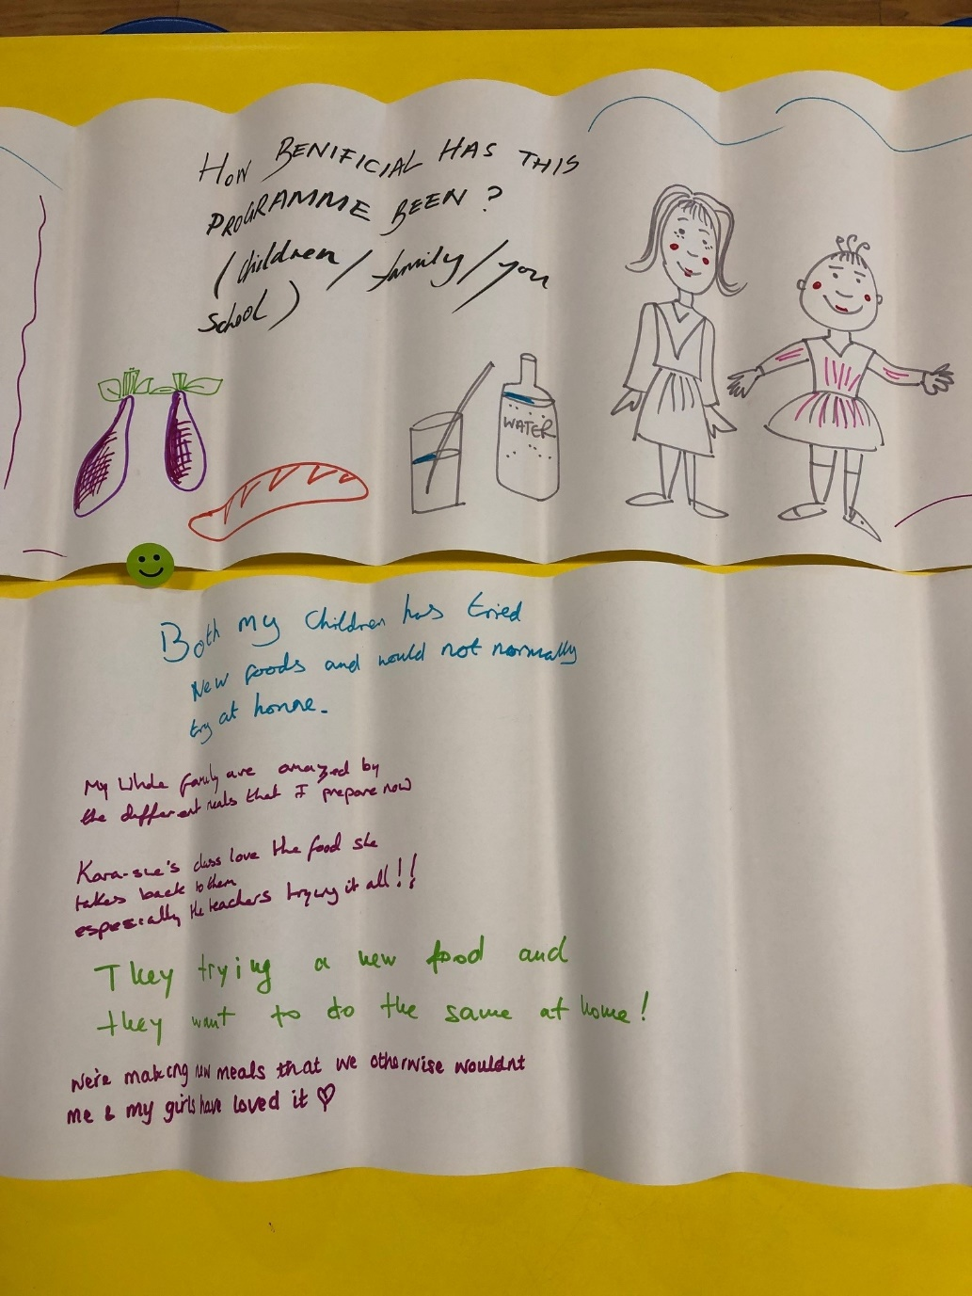
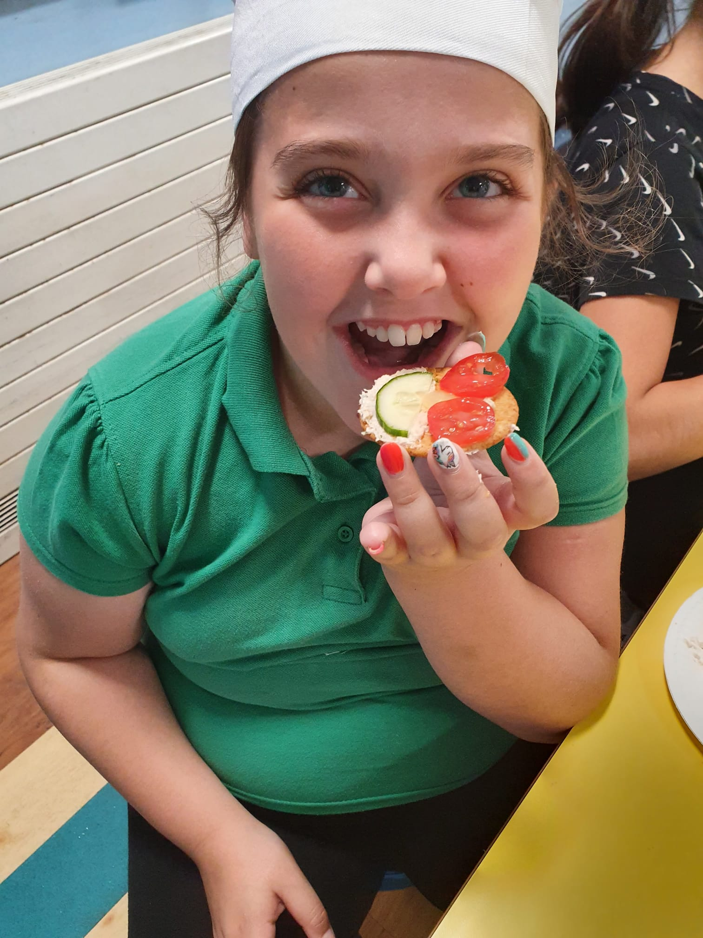
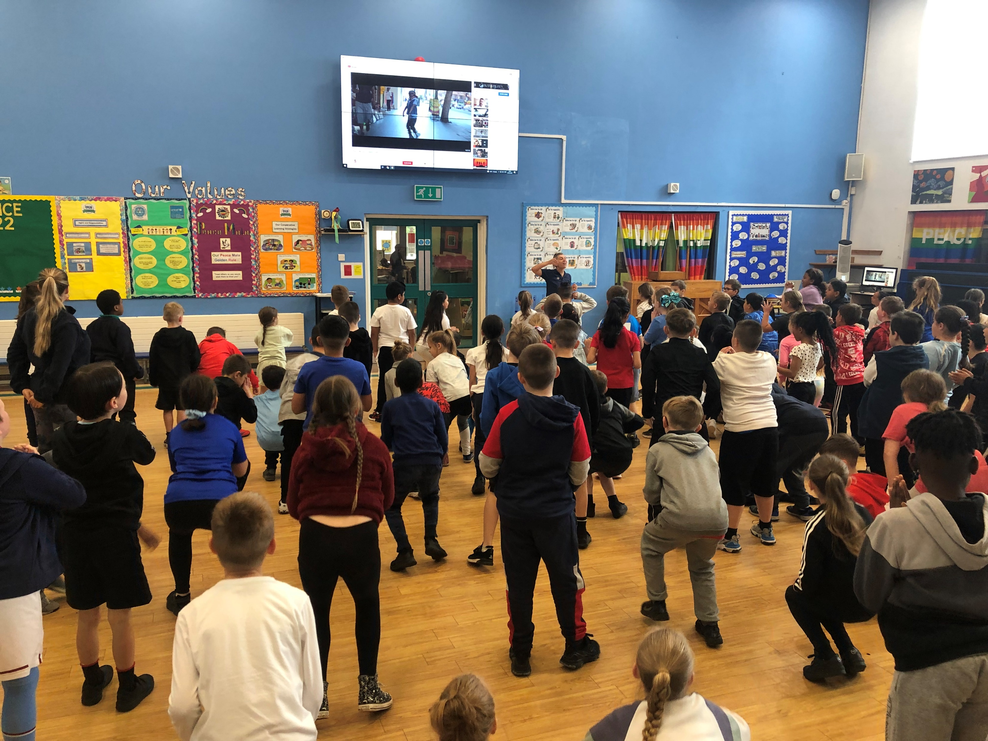
Eat Well, Move More, Feel Better
Where we are now
Individual family outcomes And some…..
Delivered one full programme at Benchill School; halfway through The Willow Programme
14 families actively engaged across two schools
Planning celebration event
Training offer complete (Making every contact count & Bringing-up the issue of healthy weight)
Healthy Weight group established in Wythenshawe - lead by HDC’s
Spread via citywide schools' newsletter – interest from North Manchester
Pooled budgets
Member of staff recruited by Everyone Active to work on Neighbourhood projects
Relationships with target schools building (Z-Arts Theatre work)
Evaluation and learning captured - Evaluation film being put together /Re:valution tool* used
*methodology for measuring full value of action in complex environments. Real time not post hoc. https://www.revaluation.org.uk/
“We are swimming every week”
“Now have confidence to cook”
“My son is enjoying school more”
“You’re such a nice team – thankyou for today”
“Not something I would have made in million years but now I’ll give it a go
“The exercise bit was the best”
2 families have joined the gym

Slide 4
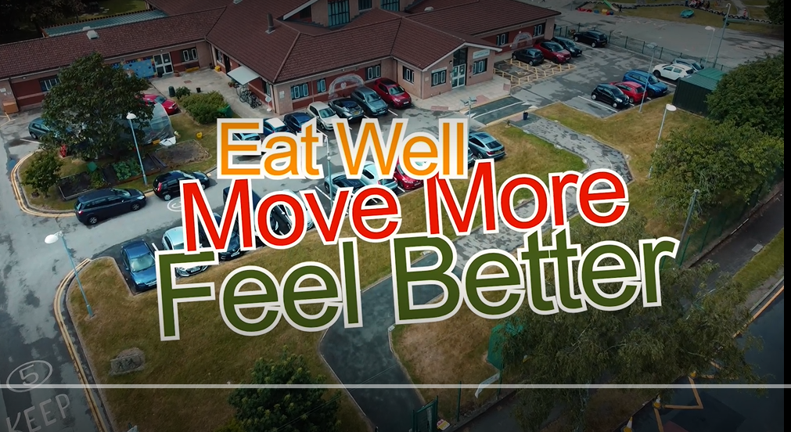
Eat Well, Move More, Feel Better
Film
Eat Well film

Slide 5
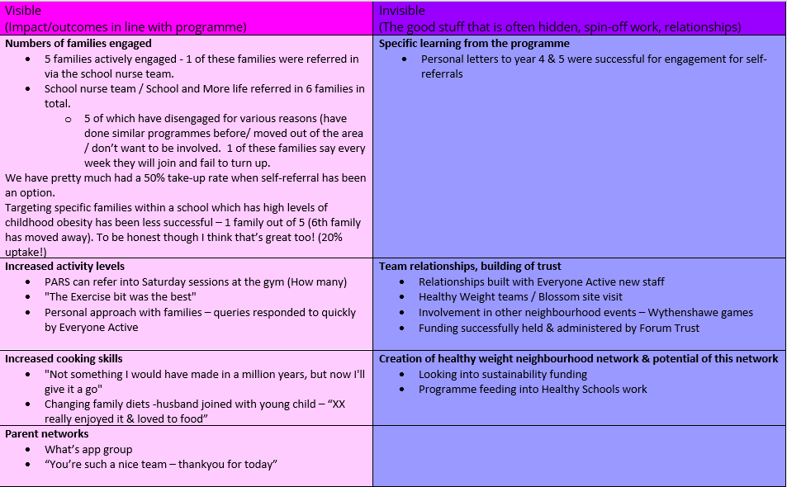
Eat Well, Move More, Feel Better
What worked
Mixture of school referrals and targeted via healthy schools' team. School referrals better involvement – personal letters out to year 4 & 5
Physiological evaluation omitted by design – BMI already established by families on healthy weight caseload. Purposefully focused on positive engagement with families from the outset
Whole school approach: Assemblies / class teacher relationships / engagement with senior leadership / Family worker at every session (The willows). Need school involvement from outset/family liaison/parent champions
Person-centred - Feedback sought throughout programme and 1st school pilot tweaked based on needs and wants. Involving them in defining the programme and celebration. Esp. timing of session, pre-pick-up 1:15-3pm
Personal approach with families – queries responded to quickly. Whats app group
Chilren and parents eating separately – trying to avoid parents transmitting thoughts & feelings
e.g Child with autism – trying different things
Parents offered food hygiene course/qualification
Turn attention to sustainability funding – Will remain targeted to build a momentum within the schools with the highest levels of obesity

Slide 6
Eat Well, Move More, Feel Better
Role of HDC
Facilitate Wythenshawe Healthy weight group(neighbourhoods mdt team)
Had an initial relationship with target school
Negotiated roles and responsibilities within project team
Pulled together a co-produced funding bid
Took over project management due to unforseen illness
Building a good working relationship with Benchill school – a neighbourhood target population
Share learning into current tier two pathways – and city strategy group
Nurture families with complex needs to become leaders and influencers
Encouraging vcse partners to take the lead with second pilot school
“

