Slide 1
Physical Activity Referral Service (PARS)
PARS has been a highly successful service for many years, but over the years, the strain on the service has seen the waiting time for enrolment reach ten weeks at its peak. This is mainly due to primary care and social prescribers' trust towards the service and the unregulated nature of community provision.
Some of the most prominent elements that contributed to the long waiting time were;
Lack of onward pathways - while there are many community activities across the city, the jump from PARS to independent community provision is only sometimes appropriate.
Questionable referrals - due to the unregulated nature of community provision, refers use PARS as their go-to physical active service rather than a specialist service.
Returning referrals - Post PARS programme, it's up to the individual to continue being active in their community. The jump from PARS to community provision can be challenging for some. In some cases, this has resulted in people returning to PARS with worsening conditions.
The Physical Activity Referral Service Pathway
Primary
Care
not quality assured
Social Prescribers
PARS
12-week Program
Community Provision
Doesn't meet the referral criteria
Don't take up community provision

Slide 2
MCRactive Physical Activity Referral Service (PARS)
'new PARS' model
Since joining MCRactive in 2023, the physical activity and movement team at MCRactive has been working with PARS to address the long waiting times and offer a better overall service. The new model creates multiple pathways but with one point of entry.
*It's important to note that everything will stay the same from an external perspective regarding how referrals are made.
The 'new PARS' model identifies three pathways of support;
Pathway 1: PARS, as we all know it. A 12-week specialist programme delivered by the Manchester Active Physical Activity Referral team. On referral, a one-to-one consultation will help to set and agree on physical activity goals.
Pathway 2: A newly created pathway aimed at those needing more support before attending independent activities. These sessions are referral-only and are delivered by qualified community instructors across the city in community venues.
Pathway 3: MCRactive Go. For anyone looking to improve their physical or mental health but with no ongoing severe health conditions. The MCRactive activities search engine aims to make finding and booking activities easier by having all activities in one place.
Primary
Care
Pathway 1
MCRactive quality
assured
PARS is a non-gym-based service, and all activities are session based.
Social Prescribers
MCRactive
Pathway 2
MCRactive quality
assured
Self-Referral (future phase)
Pathway 3
MCRactive quality
assured

Slide 3
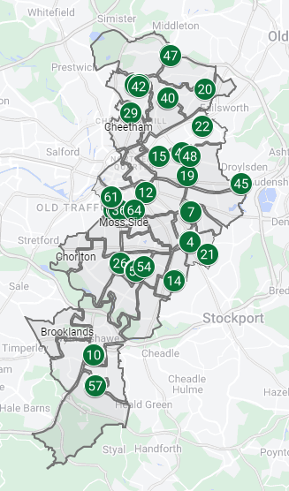
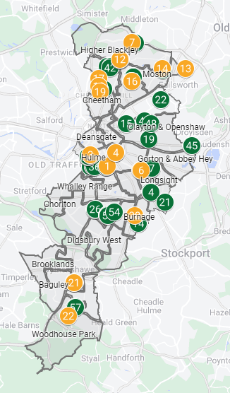
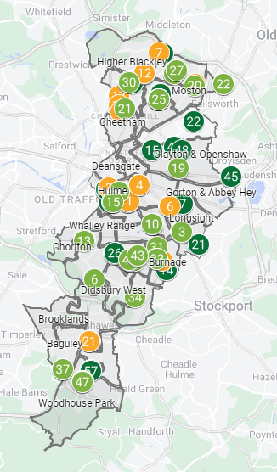
MCRactive Physical Activity Referral Service (PARS)
Additional Capacity of Pathway 2
Currently, Pathway 2 is providing an additional 22 weekly sessions funded by MCRactive but delivered by qualified community instructors.
The team has identified a further 47 weekly sessions being delivered in communities that have the potential to become a part of Pathway 2.
During the first quarter (Apr-June), 639 people were either discharged from pathway 1 into pathway 2 or bypassed pathway 1.
While the new pathway is releasing capacity and opening PARS to more conditions, less than 20% took up the offer of pathway 2.
This is where the new team structure will support better uptake and the needs of communities.
PARS Pathway 1 Sessions
(64 weekly sessions)
PARS Pathway 2 Sessions (funded)
(22 weekly sessions)
PARS Pathway 2 Session (not funded)
(47 weekly sessions)

Slide 4
MCRactive Physical Activity Referral Service (PARS)
Neighbourhood Approach
We've redesigned how we work to ensure that the 'new PARS' model delivers the best service for residents. Instead of operating as multiple teams, each responsible for a part of the service, we've decided to prioritise the users' needs.
By operating as area/ neighbourhood teams and having representation from each part of the service working as one, we can better design for each community and better connect with the wider health and neighbourhood teams.
Each city area, North, Central, and South Manchester, will have a team of five; a Manager, a Neighbourhood Officer, x2 Referral Officers, and a PARS Tutor.
MANAGER
NEIGHBOURHOOD OFFICER
x2 REFERRAL OFFICER
PARS TUTOR
The manager's role is to connect MCRactive and represent physical activity at a neighbourhood level. This will include contributing to the INT's and MCC's TAN to ensure that physical activity is placed at the heart of all health initiatives. Managers are expected to use data and neighbourhood health priorities to shape PARS, ensuring the service meets each neighbourhood's needs.
Neighbourhood Officers will work with community instructors and physical activity providers to support the growth and progression through pathways. They will also look at engagement with residents to increase uptake across all three pathways and use neighbourhood health priorities to co-design short-term projects with PCNs and social prescribers.
Referral Officers will continue to run clinics and support with pathway 1 delivery. They will also work alongside neighbourhood officers to identify capacity issues, ensuring the service meets demand.
PARS Tutors will continue to deliver pathway 1 sessions. They will also support neighbourhood officers with engagement to ensure progression between pathways are as smooth and seamless as possible.

Slide 5
MCRactive Physical Activity Referral Service (PARS)
The benefits of the new model
Having one point of entry for physical activity and movement referrals.
With the creation of Pathway 2, five additional conditions have been added to the referral criteria - anxiety, depression, stress, deconditioning, weight management, and breathlessness.
MCRactive takes ownership of quality assuring all community providers delivering as part of Pathway 2.
Pathway 2 creates a natural step down from Pathway 1 and then onto Pathway 3.
At the point of launch, Pathway 2 provides an additional 22 weekly sessions to PARS.
Working with community providers in Pathway 2 helps to close the gap between primary care and communities. Also, it helps to de-medicalise physical activity as a treatment/ management for long-term health conditions.
Creating north, central and south teams allows us to connect better and align our resources to the PCNs and MCC neighbourhood health priorities.
Each area will consist of a manager, a neighbourhood officer, two referral officers, and a physical activity tutor.

Slide 6
MCRactive Physical Activity Referral Service (PARS)
PARS Video V4.mp4

